Slide 1
Transformers, Graph Neural Network, and Generative Adversarial Networks
BIO 4990/6990
Dr. Megan Smith
April 3, 2024

Slide 2
Looking Forward
Date | Plan
4/3/24 | Lecture: Transformers, GNNs, and GANs
4/5/24 | Lecture: Unsupervised Learning—Clustering
4/8/24 | Lecture: Unsupervised Learning—Dimensionality Reduction
4/10/24 | Lecture: Unsupervised Learning
4/12/24 | Computational Activity: Unsupervised Learning
4/15/24 | Discussion 5: Domain Adaptation (Led by K. Cobb)
4/17/24 | Class Cancelled

Slide 3
Outline
Transformer Neural Networks
Review of RNNs and LSTMs
Sequence-to-sequence models
Motivation for Transformers
Transformer Neural Networks
Examples of RNNs and Transformers
Graph Neural Networks
Motivation for GNNs
GNN Tasks
General structure of a GNN
Generative Adversarial Networks
Structure of GANs
Examples of GANs

Slide 4
Outline
Transformer Neural Networks
Review of RNNs and LSTMs
Sequence-to-sequence models
Motivation for Transformers
Transformer Neural Networks
Examples of RNNs and Transformers
Graph Neural Networks
Motivation for GNNs
GNN Tasks
General structure of a GNN
Generative Adversarial Networks
Structure of GANs
Examples of GANs

Slide 5
Review of RNNs and LSTMs
Recurrent Neural Networks (RNNs) use feedback loops to process different amounts of sequential input.
input
output
w₁
b₁
w₃
b₂
x1.8
sum
+0.0
ReLU
x1.1
+0.0
w₂
x-0.5

Slide 6
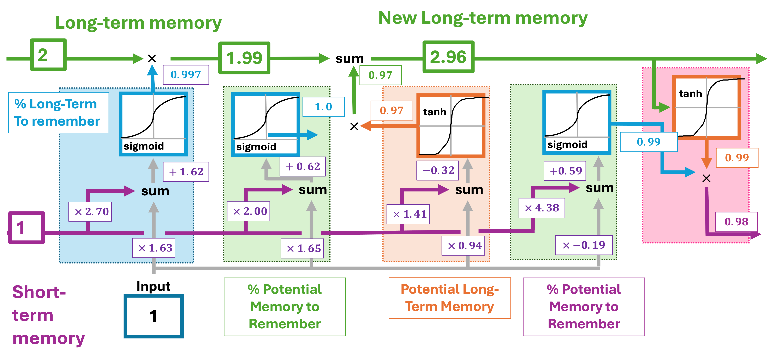
Review of RNNs and LSTMs
Long Short-Term Memory Networks address the vanishing and exploding gradient challenges associated with standard RNNs.

Slide 7
Sequence-to-sequence models
Now, imagine our goal is to translate from one sequence of words to another sequence of words (e.g., language translation)
A very early approach to this relied on models composed of multiple recurrent neural networks.
Encoder: A recurrent neural network
Decoder: A recurrent neural network
One-hot encoded input
One-hot encoded output
hidden state

Slide 8
Sequence-to-sequence models
Input is passed to encoder one word at a time.
The output of the encoder is the hidden state.
This hidden state is run through the decoder n times to produce n outputs.
The loss is a comparison between known outputs and predicted outputs.
Encoder: A recurrent neural network
Decoder: A recurrent neural network
One-hot encoded input
One-hot encoded output
hidden state

Slide 9
Problems with simple sequence-to-sequence models
The vanishing gradient problem persists, even if networks like LSTMs are used, particularly with long sequences.
Each input must be processed one word at a time, which causes long processing times for long sequences.
Transformers can solve many of these issues.
Encoder: A recurrent neural network
Decoder: A recurrent neural network
One-hot encoded input
One-hot encoded output
hidden state

Slide 10
Transformers: Encoder
Transformers consist of two major components: encoder and decoder.
The encoder consists of four major components:
Word Embedding (encodes words to numbers)
Positional Embedding (encodes the positions of words in the sentence)
Self-Attention (encodes relationships among words in the sentence)
Residual Connections (facilitates training by allowing each stage of the network to focus on one task).
At step one, we pass each word in the input through the encoder, which can be done in parallel.

Slide 11
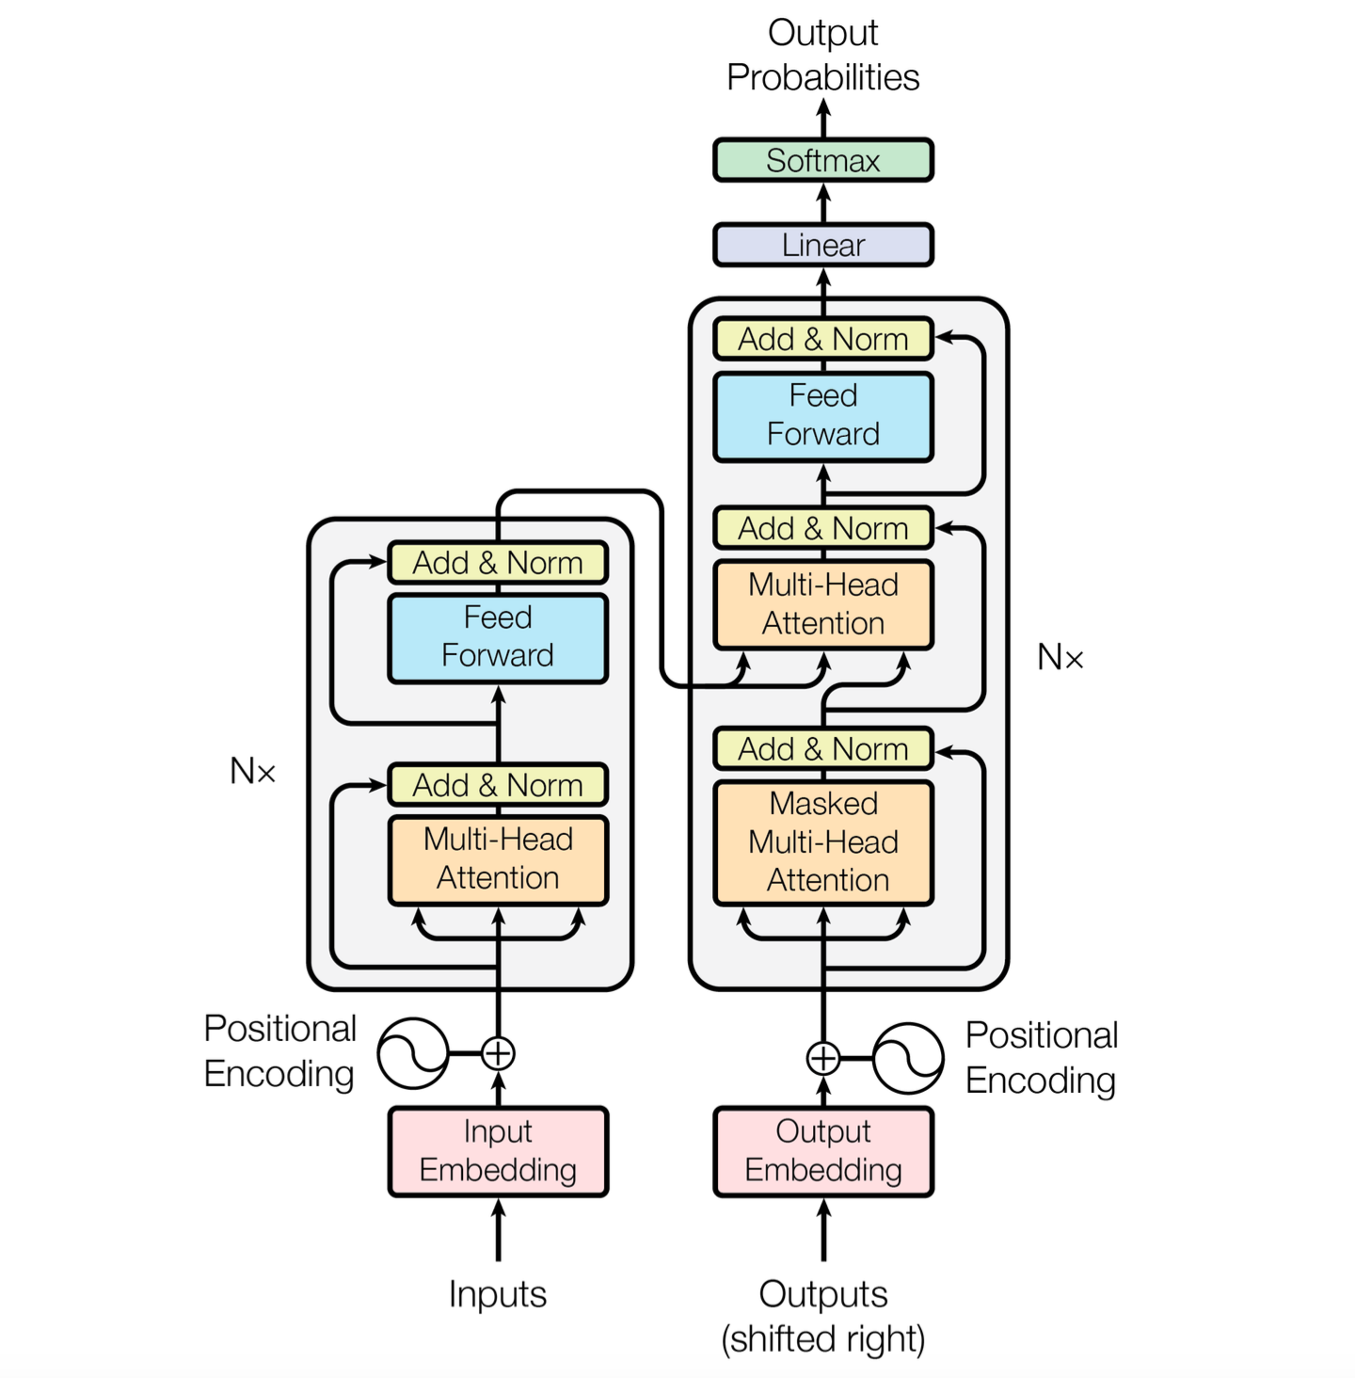
Transformers: Encoder
Word Embedding (encodes words to numbers)
Positional Embedding (encodes the positions of words in the sentence)
Self-Attention (encodes relationships among words in the sentence)
Residual Connections (facilitates training by allowing each stage of the network to focus on one task).

Slide 12
Transformers: Encoder
Each word is passed through the encoder.
Computations can be done in parallel across words.
The same weights and biases are used to encode each word, meaning variable input sizes is accommodated.
We can repeat the attention blocks and feed-forward networks for additional complexity.

Slide 13
Transformers: Decoder
The decoder consists of the same four components as the encoder plus additional components:
Word Embedding (encodes words to numbers)
Positional Embedding (encodes the positions of words in the sentence)
Self-Attention (encodes relationships among words in the sentence)
Residual Connections (facilitates training by allowing each stage of the network to focus on one task).
Encoder-Decoder Attention (allows decoder to keep track of significant words in the input.
Final output layer (combines encoder-decoder attention and decoder output to predict words).

Slide 14
Transformer: Decoder
Word Embedding (encodes words to numbers)
Positional Embedding (encodes the positions of words in the sentence)
Self-Attention (encodes relationships among words in the sentence)
Residual Connections (facilitates training by allowing each stage of the network to focus on one task).
Encoder-Decoder Attention (allows decoder to keep track of significant words in the input.
Final output layer (combines encoder-decoder attention and decoder output to predict words).

Slide 15
Transformer: Decoder
We begin an ‘end of sentence’ token.
We run the first token through the decoder, and combine it with information from the encoder using encoder-decoder attention.
Once we have the output, we begin with this as the input for the next prediction.
We end up with a complete sentence.

Slide 16
Transformer Summary
Transformers consist of encoders and decoders.
Words can be passed into the input simultaneously, allowing transformers to work for long sentences.
Transformers accept variable-sized input and create variable-sized output.

Slide 17
RNN Example: ReLERNN
Goal: Estimate a genome-wide recombination map from a genome alignment
Architecture: Gradient Recurrent Unit (similar to LSTM, but has fewer parameters).
Training data are simulated.
Input: Genomic data
Output: Recombination rates across the genome.
Adrion et al., 2020

Slide 18
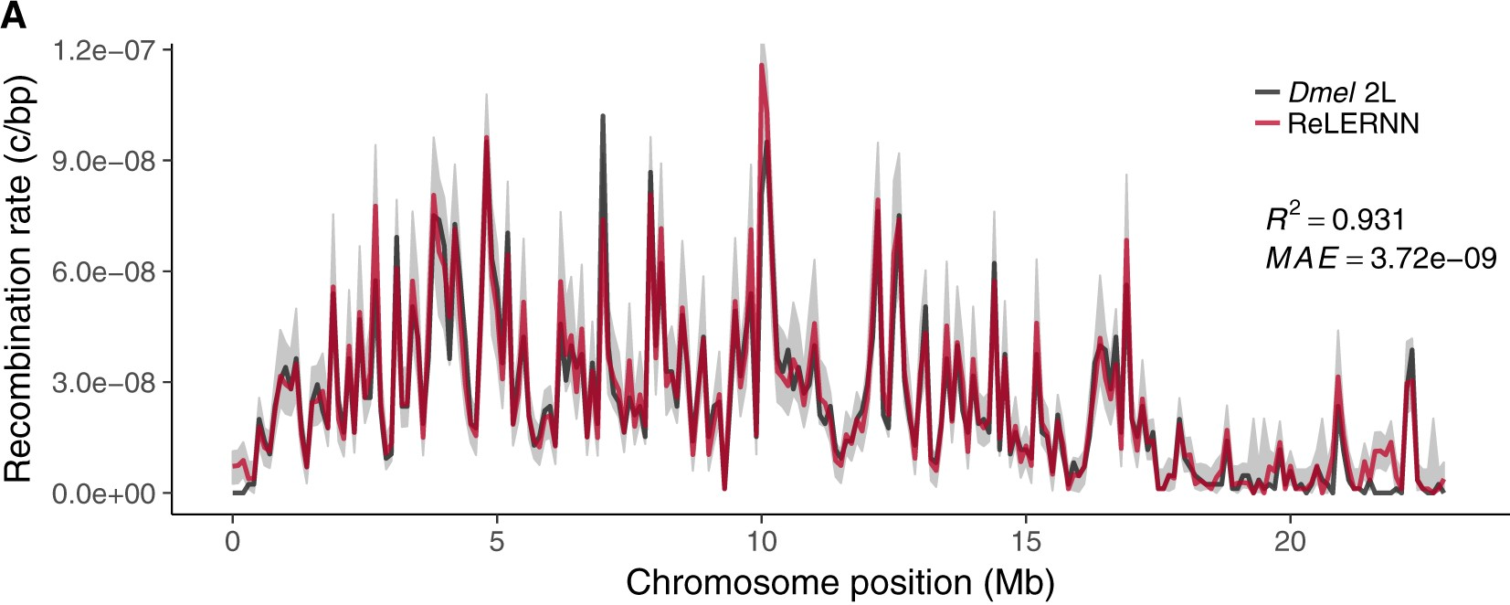
RNN Example: ReLERNN
Adrion et al., 2020

Slide 19
Transformer Example: AlphaFold
Goal: Predict protein structure from sequences
Architecture: A really complicated model including transformers!
Training data are taken from public databases.
Input: Amino acid sequences
Output: Protein 3D Structure.
Jumper et al., 2021

Slide 20
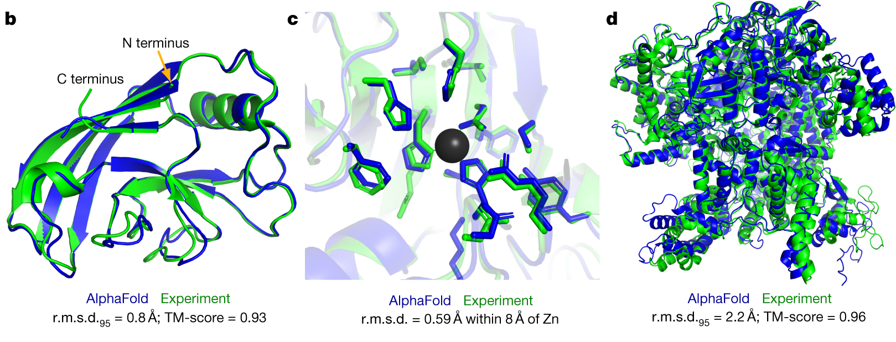
Transformer Example: AlphaFold
Jumper et al., 2021

Slide 21
Outline
Transformer Neural Networks
Review of RNNs and LSTMs
Sequence-to-sequence models
Motivation for Transformers
Transformer Neural Networks
Examples of RNNs and Transformers
Graph Neural Networks
Motivation for GNNs
GNN Tasks
General structure of a GNN
Generative Adversarial Networks
Structure of GANs
Examples of GANs

Slide 22
Graphs
Some data are easily represented as graphs
Social networks
Molecular structures
Phylogenies
Graphs naturally represent sets of objects and the connections between them.

Slide 23
Graphs
Graphs have vertexes (nodes), edges (links), and global attributes.
1
2
3
4
5

Slide 24
Problems to solve with graphs
Graph-level tasks: predict a property of the entire graph (e.g., predict the function of a molecule).
Node-level tasks: predict something about each node in a graph (e.g., predict to which club individuals belong).
Edge-level tasks: predict how nodes are connected

Slide 25
How do we represent graphs?
Node feature matrix: encodes information associated with each node
Adjacency matrix: encodes how nodes are connected.
1
2
3
4
5
1
1
2
2
3
3
4
4
5
5

Slide 26
How do we represent graphs?
Node feature matrix: encodes information associated with each node
Adjacency matrix: encodes how nodes are connected.
Adjacency lists are more compact and better for representing sparse graphs (i.e., graphs with many nodes and few connections).
1
2
[[1,3],[1,4],[2,3],[3,1],[3,2],[4,1],[4,5],[5,1]]
3
4
5

Slide 27
How do GNNs work?
Recall how convolutions work: we slide a filter over an image and calculate values of a feature map.
For GNNs, we look at nearby nodes, and do computations using that information.

Slide 28
2 layered GNN
1
1
2
3
3
4
4
5
1
5
2
1

Slide 29
Message-passing
1
2) Aggregation
1) Message
GNN Layer 1
3
4
1
5
2
1

Slide 30
Key Ideas
Information propagates through the network from nearby nodes to further away nodes.
More layers means that we consider deeper connections.
This leads to a trade-off:
If the network is not deep enough, we won’t consider nodes that are further away in the graph.
If the network is too deep, we will over-smooth and lose information from nearby nodes.

Slide 31
Key Ideas
Permutation invariance: the ordering of nodes in the node feature matrix and the adjacency matrix should not matter!
1
1
2
2
3
3
4
4
5
5

Slide 32
GNN Summary
GNNs are used to analyze data that is naturally represented as a graph.
Shallow-layers consider nearby connections, while deeper layers incorporate information for further away connections.
GNNs can be used to make predictions about the entire graph, specific nodes, or to predict edges (amongst other things)!

Slide 33
Outline
Transformer Neural Networks
Review of RNNs and LSTMs
Sequence-to-sequence models
Motivation for Transformers
Transformer Neural Networks
Examples of RNNs and Transformers
Graph Neural Networks
Motivation for GNNs
GNN Tasks
General structure of a GNN
Generative Adversarial Networks
Structure of GANs
Examples of GANs

Slide 34
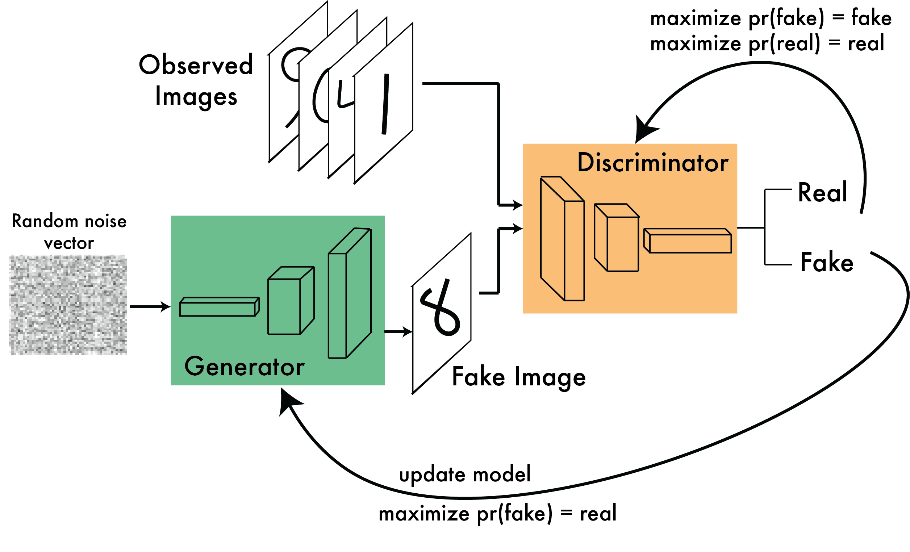
Generative Adversarial Networks (GANs)

Slide 35
Generative Adversarial Networks (GANs)
GANs include a generator and a discriminator.
The generator learns to make realistic data.
The discriminator learns to distinguish real from generated data.
Training GANs is a delicate balance, where if either component learns too fast, the other will fail!

Slide 36
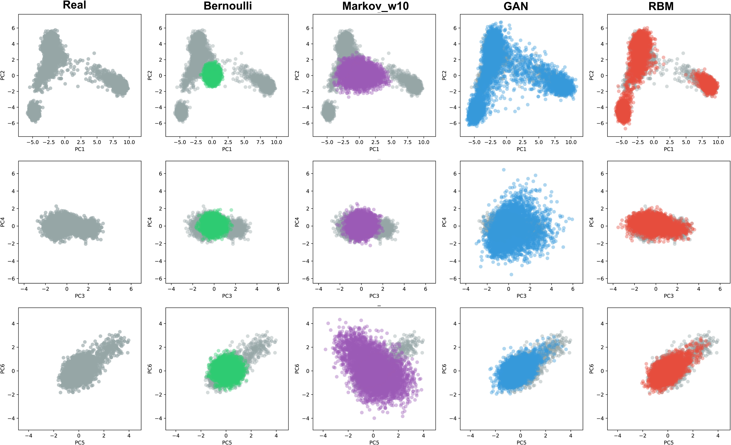
GAN Example: Artificial Genomes
Goal: generate realistic artificial genomes
Input: real genomes
Output: realistic looking genomes
Yelmen et al., 2021

Slide 37
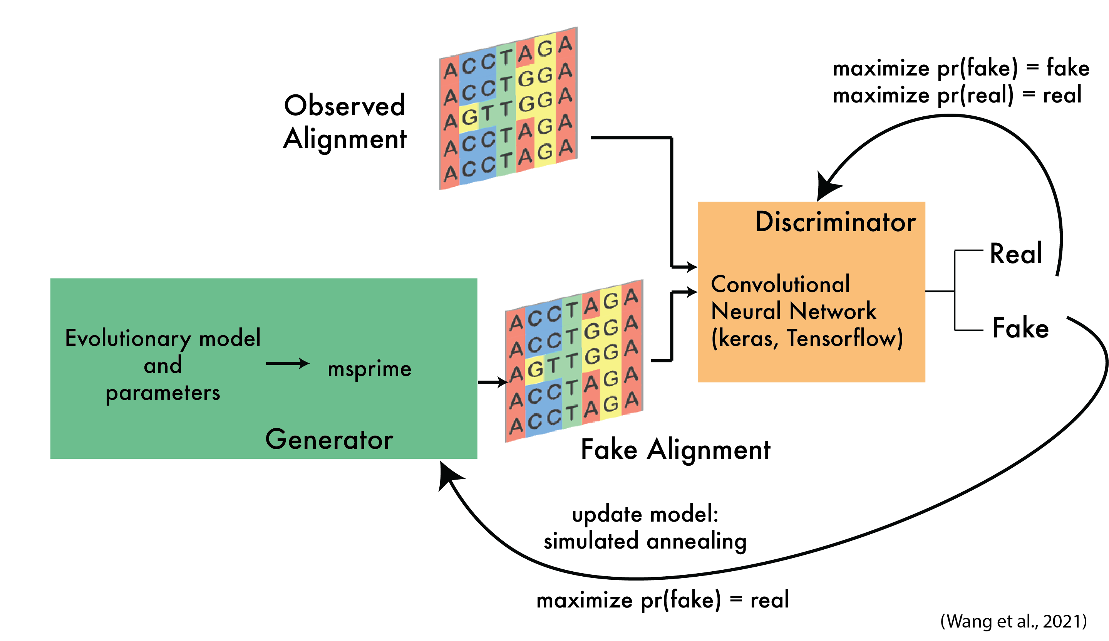
GAN Example: pg-gan
Goal: infer evolutionary parameters (e.g. population size)
Input: sequence alignment
Output: parameters of an evolutionary model
This usage assumes that the parameters that lead to the production of the most realistic alignments are the best parameters for the data.

Slide 38
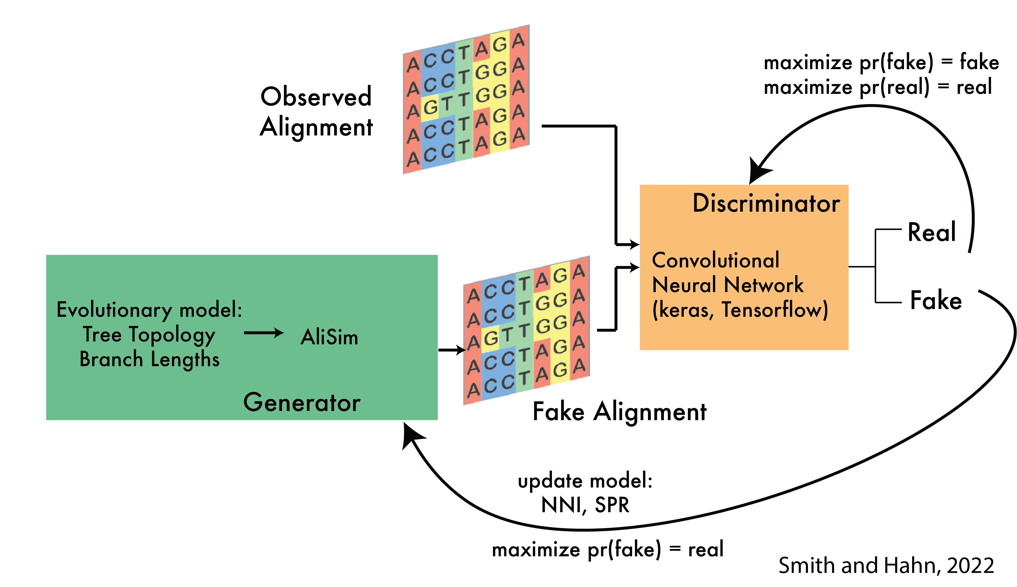
GAN Example: phyloGAN
Goal: infer phylogenetic tree topology from a sequence alignment
Input: sequence alignment
Output: tree topology
This usage assumes that the tree that leads to the production of the most realistic alignments is the best tree for the real data.

Slide 39
GAN Summary
GANs include a generator, which aims to create realistic fake data, and a discriminator, which aims to distinguish real from fake data.
GANs are challenging to train.
GANs can be used to infer models and parameters if we assume that the true models and parameters are the most likely to generate realistic fake data.

Slide 40
Outline
Transformer Neural Networks
Review of RNNs and LSTMs
Sequence-to-sequence models
Motivation for Transformers
Transformer Neural Networks
Examples of RNNs and Transformers
Graph Neural Networks
Motivation for GNNs
GNN Tasks
General structure of a GNN
Generative Adversarial Networks
Structure of GANs
Examples of GANs

